Slide 1
VISUAL C#.NET session 14
Instructor: Edwin oduor

Slide 2
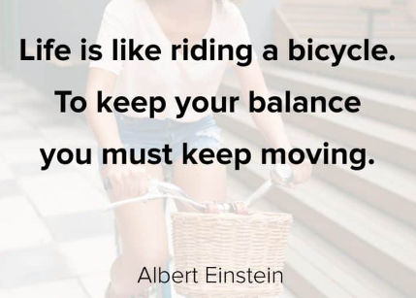
Quote of the day

Slide 3
Lesson objectives
OOP Principles
Class
Object
Illustration a class and Object
Pillars of OOP
Abstraction
Real Life Examples of Abstraction
Encapsulation
Inheritance
Types of Inheritance
Polymorphism
Access Modifiers

Slide 4
Lesson pre-requisites
In order to take full advantage of this section you need to have the following;
Computer with Visual Studio Installed.
Stable Network Connection.

Slide 5
Training methods and extra readings
TRAINING METHODS FOR THIS LESSON
EXTRA READINGS
Lecturing Method – This is the main method of training to be adopted in this lesson with illustrations and practical coding examples.
Discussion Method - This method will be adopted periodically whereby learning will be derived principally from the students brainstorming together, rather than from the trainer. Three main types of discussions will be used:
Directed discussion
Developmental discussion
Problem-Solving discussion
Home and Learn C#

Slide 6
OBJECT ORIENTED PROGRAMMING (OOP) continuation

Slide 7
encapsulation

Slide 8
What is encapsulation?

Slide 9
Encapsulation is to set a field or methods using private key words hence accessing the fields or methods outside the class will be made impossible can only be accessed using getters and setters, though nowadays C# uses properties. Which will be covered shortly.

Slide 10
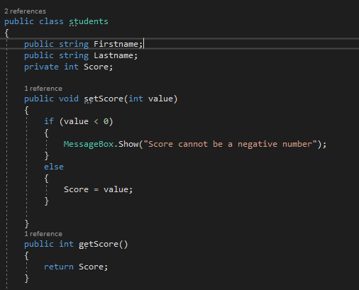
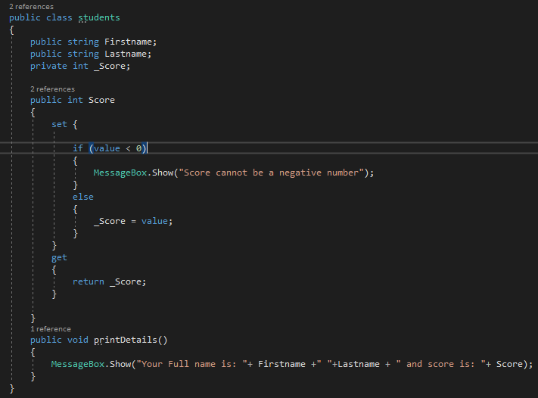
encapsulation
To change this code so that we use properties then slight amendments will be done.
In this code we are now using properties slight amendment has been done.

Slide 11
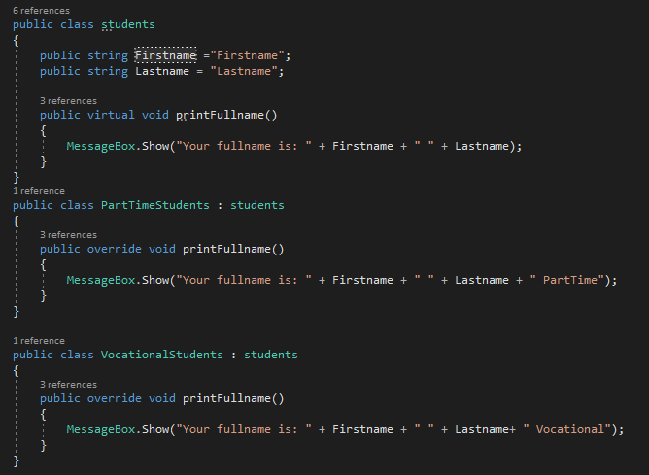
polymorphism

Slide 12
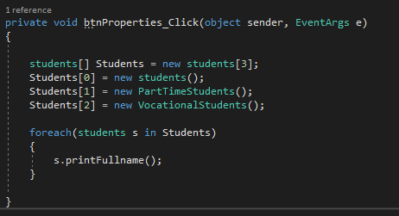
polymorphism
From the code, we have three classes and each class has a method and its implementation. In the base class we are adding the word virtual to our method, this is used in the method because we want to allow this method to be overridden by other methods, all the other methods have the same name as the method in the base class, but for the derived class we are using override in the methods so that, it can override the method in the base class. The output of the methods is to print the name of students and next to it print if it’s a part time or vocational student next to the name.
Polymorphism allows one to invoke a derived class through a base class. From the above code we are calling the derived class from the base class.

Slide 13
INTERFACE

Slide 14
WHAT IS INTERFACE

Slide 15
Interfaces in simple words is a contract. Just as the normal contract that is between two people, or between an employee and employer, whereby from the contract an employee is given by an employer and both parties should abide by what is stated in the contract.
When creating an Interface, the interface is going to have methods but no implementation, the class that is going to inherit the interface is going to implement the methods that are inside an Interface.

Slide 16
Key points to note when using interfaces
Interfaces can contain declaration and no implementation
Interface members are public by default, that does not mean that we use public key words
Interface cannot have fields
Interfaces can be implemented by class that is inheriting from it- the class inheriting from the interface has to provide implementation.
Classes allow multiple Interface inheritance.

